Slide 1





Ministry of Electronics and Information Technology
Government of India
y
Job Scheduler (SLURM)

Slide 2
Topics
Workload Managers
Slurm Introduction
SLURM Architecture
SLURM Commands
Sample SLURM Job Script
OpenMP Examples
Exercise

Slide 3
Workload Managers
System to allocate shared compute resources to users of a large compute system
Shared compute resources are often under contention
- There is more compute work to be done than compute resources available at any given
moment
Workload is managed by a resource manager and a job scheduler
Resource manager:
- Monitors node availability and load (usage)
- Manages CPU, network, disk, memory, etc. in a cluster
Job scheduler:
- Sends compute tasks to nodes
- Manages queues and priority

Slide 4
Workload Managers (...contd)
Some factors for determining which jobs get run:
- Current system load
- Submitting user’s fair-share usage
- Submitted job’s requested resources

Slide 5
Workload Managers (...contd)
Several solutions to this problem:
Portable Batch System (PBS)
Simpler Linux Utility for Resource Management (SLURM)
Moab
Univa Grid Engine
LoadLeveler, Condor
OpenLava
IBM’s Platform LSF
…

Slide 6

Introduction to SLURM
Simple Linux Utility for Resource Management
Open source cluster management and job scheduling system
Slurm is both a resource manager and job scheduler
Official documentation : https://slurm.schedmd.com/documentation.html

Slide 7
Terminologies
Job
a reservation on the system to run commands
Node
physical machine that is part of the cluster. The cluster is made up of many connected nodes
Core/CPU
single processing unit for computing. One node contains many cores or CPUs
Partition
Queue for jobs. Has resource limits and access control.
Quality of Service (QoS)
special limits for a given partition or user

Slide 8
SLURM Functions
Allocate access to resources
SLURM has 3 main functions:
Provides a framework to run and monitor jobs on allocated nodes
Manages a job queue for competing resource requests

Slide 9
SLURM Jobs (things to be noted)
On a HPC cluster many jobs may be running at the same time
If the resources requested by a user’s job are not free, the job will be put in queue and will be taken up for execution once the resources are available
To minimize the waiting time in queue, the requested resources such as execution time, number of nodes and cores per node must be carefully chosen within the job script
If the actual job execution exceeds the time duration specified in the job script, the job will be terminated

Slide 10
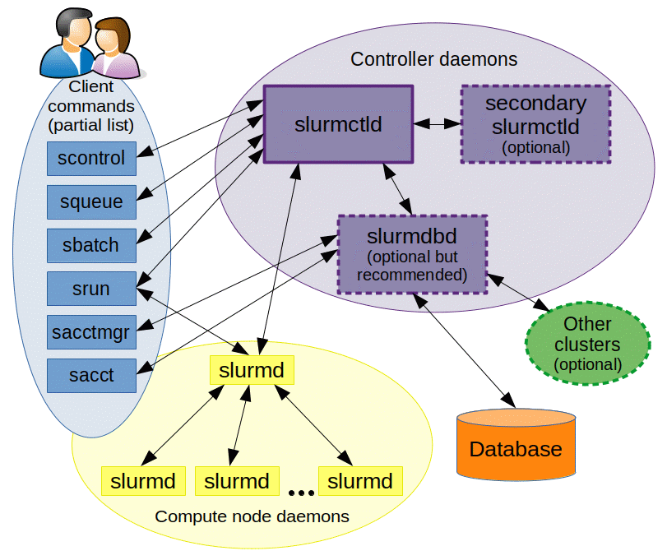
SLURM Architecture
slurmctld : Central controller (typically one per cluster)
Monitors state of resources
Manages job queue
Allocates resources
Optional backup with automatic failover
slurmd : Compute node daemon (typically one per compute node)
Launches and manages task
Support hierarchical communication
Small and lightweight
slurmdbd : Database daemon (typically on per cluster)
Collects accounting information
Uploads configuration information
Optional backup with automatic failover

Slide 11
Modes of program execution
Interactive mode
similar way of using a personal computer
can be enabled/disables on HPC systems (depending upon requirements)
jobs may have to wait in a queue
used for testing and debugging purposes
Batch mode
refers to program execution in background
user jobs are accepted and typically wait in queues before adequate resources are available to the job and then it is scheduled for execution

Slide 12
Backfill Algorithm
lower priority jobs can start earlier to fill the idle slots provided they are finished before the next high priority jobs is expected to start based on resource availability.
To find out which solution is implemented on a cluster, you can issue the following command:
scontrol show config | grep SchedulerType

Slide 13
Backfill Algorithm
R
E
S
O
U
R
C
E
S
Job 1
Job 2
Jobs 1, 2 and 3 are running
Job 3
TIME

Slide 14
Backfill Algorithm
R
E
S
O
U
R
C
E
S
Job 1
Job 2
Jobs 1, 2 and 3 are running
Job 4 can not start, waiting for Job 2 to finish
Job 4
Job 3
TIME

Slide 15
Backfill Algorithm
R
E
S
O
U
R
C
E
S
Job 1
Job 2
Jobs 1, 2 and 3 are running
Job 4 can not start, waiting for Job 2 to finish
Job 5 can start now on available resources if and only if it finishes before completion of Job 2 (when Job 4 can start)
Job 4
Job 5
Job 3
TIME

Slide 16
SLURM Useful Commands
sinfo - display node partition
squeue - display the jobs in the scheduling queue
salloc - request an interactive job session
sbatch - submit a batch script to slurm
srun - resource allocation (for parallel jobs)
scontrol - display the status of jobs, nodes, partitions, reservations, etc.
scancel - cancel a submitted job

Slide 17
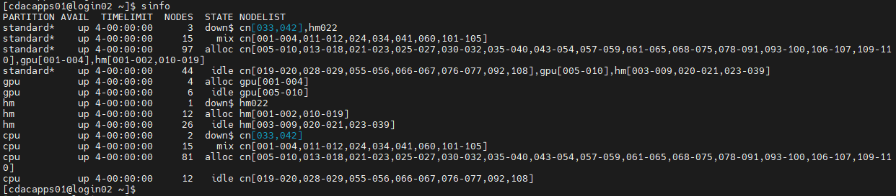
SLURM Commands (...contd)
-sinfo reports the state of partitions and nodes managed by Slurm. It has a wide variety of filtering, sorting, and formatting options.

Slide 18
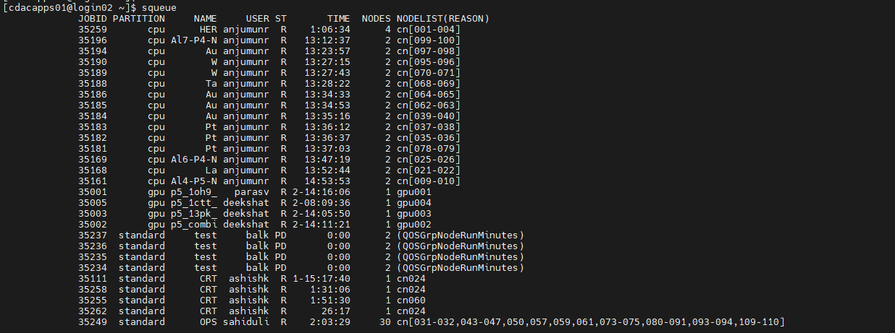
SLURM Commands (...contd)
-squeue reports the state of jobs or job steps. It has a wide variety of filtering, sorting, and formatting options. By default, it reports the running jobs in priority order and then the pending jobs in priority order.

Slide 19
SLURM Commands (...contd)
scontrol command can be used to report more detailed information about nodes, partitions, jobs, job steps, and configuration.
It can also be used by system administrators to make configuration changes
scontrol show partition
scontrol show node <nodename>
scontrol show job <job_id>
scontrol show res
scontrol create res (can be run from root access only)

Slide 20
SLURM Commands (...contd)
- sbatch is used to submit a job script for later execution. The script will typically contain one or more srun commands to launch parallel tasks.
sbatch <my_sample_script>
- salloc is used to allocate resources for a job in real time.
salloc --time=1:00:00 --partition=gpu --nodes=1

Slide 21
SLURM Commands (...contd)
- srun is used to submit a job for execution or initiate job steps in real time.
srun --nodes=1 --ntasks-per-node=1 --time=01:00:00 --pty bash -i
srun --time=1:30:00 --mem=3000 --gres=gpu:1 --pty /bin/bash
Sequential (one CPU on one node) | srun --pty bash
Parallel (shared memory) (n CPUs on one node) | srun --nodes=1 --tasks-per-node=1 --cpus-per-task=n --pty bash
Parallel (distributed memory) (n CPUs on each of m nodes) | srun --ntasks-per-node=n --nodes=m --cpus-per-task=1 --pty bash

Slide 22
SLURM Commands (...contd)
- scancel cancel a submitted job
scancel <jobid>
scancel -u <username>
scancel -t PENDING -u <username>
scancel –name <myjobname>

Slide 23
Running SLURM : Sample script
#!/bin/bash
#SBATCH --nodes=1
#SBATCH --ntasks-per-node=1
#SBATCH --time=00:20:00
#SBATCH --mail-type=ALL
#SBATCH --mail-user=him1234@gmail.com
#SBATCH -p standard
#SBATCH -o %j.out
#SBATCH -e %j.err
srun hostname
srun echo ${SLURM_JOBID}

Slide 24
Running SLURM : Sample script (...contd)
Send the job to the scheduler with the sbatch command: sbatch sample.sh
You will see text like “Submitted batch job 35298” get written to the terminal
Two files will be generated:
<job_id>.err
<job_id>.out

Slide 25
Running SLURM : Serial job
#!/bin/sh
#SBATCH -N 1 # specify number of nodes
#SBATCH --ntasks-per-node=1 # specify number of CPU cores per node
#SBATCH --time=00:10:00 # specify maximum duration of run in
hours:minutes:seconds format
#SBATCH --job-name=hello # specify job name
#SBATCH --error=job.%J.err # specify error file name
#SBATCH --output=job.%J. out # specify output file name
#SBATCH --partition=cpu # specify type of resource such as CPU/GPU/High
memory etc
cd $SLURM_SUBMIT_DIR # change to directory from where job is submitted
### Set your environment (e.g. load required compiler, application)
module load intel/oneapi/mpi/2021.4.0
### Your command for Serial Execution (i.e. execution on one CPU core)
time ./<executable>

Slide 26
Running SLURM : OpenMP jobs
#!/bin/bash
#SBATCH --job-name=openmp
#SBATCH --ntasks=1
#SBATCH --cpus-per-task=4
#SBATCH --time=10:00
#SBATCH --output=ompresult.txt
export OMP_NUM_THREADS=$SLURM_CPUS_PER_TASK
srun ./hello.omp

Slide 27
Running SLURM : MPI job
#!/bin/sh
#SBATCH -N 2 # specify number of nodes
#SBATCH --ntasks-per-node=2 # specify number of cores per node
#SBATCH --time=01:00:00 # specify maximum duration of run in
hours:minutes:seconds format
#SBATCH --job-name=mpi_hello # specify job name
#SBATCH --error=job.%J.err # specify error file name
#SBATCH --output=job.%J. out # specify output file name
#SBATCH --partition=standard # specify type of resource such as CPU/GPU/High
memory etc.
### Load the default MPI module
module load intel/oneapi/mpi/2021.4.0
### Run the mpi program with mpirun
mpirun -np $SLURM_NTASKS ./hello.mpi

Slide 28
Exercise : Creating Parallel environment
you use mpi and do not care about where those cores are distributed:
you want to launch 16 independent processes (no communication):

Slide 29
Exercise : Creating Parallel environment
you use mpi and do not care about where those cores are distributed: --ntasks=16
you want to launch 16 independent processes (no communication): --ntasks=16

Slide 30
Exercise : Creating Parallel environment
you use mpi and do not care about where those cores are distributed: --ntasks=16
you want to launch 16 independent processes (no communication): --ntasks=16
you want those cores to spread across distinct nodes:

Slide 31
Exercise : Creating Parallel environment
you use mpi and do not care about where those cores are distributed: --ntasks=16
you want to launch 16 independent processes (no communication): --ntasks=16
you want those cores to spread across distinct nodes: --ntasks=16 --ntasks-per-node=1 or --ntasks=16 --nodes=16

Slide 32
Exercise : Creating Parallel environment
you use mpi and do not care about where those cores are distributed: --ntasks=16
you want to launch 16 independent processes (no communication): --ntasks=16
you want those cores to spread across distinct nodes: --ntasks=16 --ntasks-per-node=1 or --ntasks=16 --nodes=16
you want those cores to spread across distinct nodes and no interference from other jobs:

Slide 33
Exercise : Creating Parallel environment
you use mpi and do not care about where those cores are distributed: --ntasks=16
you want to launch 16 independent processes (no communication): --ntasks=16
you want those cores to spread across distinct nodes: --ntasks=16 --ntasks-per-node=1 or --ntasks=16 --nodes=16
you want those cores to spread across distinct nodes and no interference from other jobs: --ntasks=16 --nodes=16 --exclusive

Slide 34
Exercise : Creating Parallel environment
you use mpi and do not care about where those cores are distributed: --ntasks=16
you want to launch 16 independent processes (no communication): --ntasks=16
you want those cores to spread across distinct nodes: --ntasks=16 --ntasks-per-node=1 or --ntasks=16 --nodes=16
you want those cores to spread across distinct nodes and no interference from other jobs: --ntasks=16 --nodes=16 --exclusive
you want 16 processes to spread across 8 nodes to have two processes per node:

Slide 35
Exercise : Creating Parallel environment
you use mpi and do not care about where those cores are distributed: --ntasks=16
you want to launch 16 independent processes (no communication): --ntasks=16
you want those cores to spread across distinct nodes: --ntasks=16 --ntasks-per-node=1 or --ntasks=16 --nodes=16
you want those cores to spread across distinct nodes and no interference from other jobs: --ntasks=16 --nodes=16 --exclusive
you want 16 processes to spread across 8 nodes to have two processes per node: --ntasks=16 --ntasks-per-node=2

Slide 36
Exercise : Creating Parallel environment
you use mpi and do not care about where those cores are distributed: --ntasks=16
you want to launch 16 independent processes (no communication): --ntasks=16
you want those cores to spread across distinct nodes: --ntasks=16 --ntasks-per-node=1 or --ntasks=16 --nodes=16
you want those cores to spread across distinct nodes and no interference from other jobs: --ntasks=16 --nodes=16 --exclusive
you want 16 processes to spread across 8 nodes to have two processes per node: --ntasks=16 --ntasks-per-node=2
you want 16 processes to stay on the same node:

Slide 37
Exercise : Creating Parallel environment
you use mpi and do not care about where those cores are distributed: --ntasks=16
you want to launch 16 independent processes (no communication): --ntasks=16
you want those cores to spread across distinct nodes: --ntasks=16 --ntasks-per-node=1 or --ntasks=16 --nodes=16
you want those cores to spread across distinct nodes and no interference from other jobs: --ntasks=16 --nodes=16 --exclusive
you want 16 processes to spread across 8 nodes to have two processes per node: --ntasks=16 --ntasks-per-node=2
you want 16 processes to stay on the same node: --ntasks=16 --ntasks-per-node=16

Slide 38
Exercise : Creating Parallel environment
you use mpi and do not care about where those cores are distributed: --ntasks=16
you want to launch 16 independent processes (no communication): --ntasks=16
you want those cores to spread across distinct nodes: --ntasks=16 --ntasks-per-node=1 or --ntasks=16 --nodes=16
you want those cores to spread across distinct nodes and no interference from other jobs: --ntasks=16 --nodes=16 --exclusive
you want 16 processes to spread across 8 nodes to have two processes per node: --ntasks=16 --ntasks-per-node=2
you want 16 processes to stay on the same node: --ntasks=16 --ntasks-per-node=16
you want one process that can use 16 cores for multithreading:

Slide 39
Exercise : Creating Parallel environment
you use mpi and do not care about where those cores are distributed: --ntasks=16
you want to launch 16 independent processes (no communication): --ntasks=16
you want those cores to spread across distinct nodes: --ntasks=16 --ntasks-per-node=1 or --ntasks=16 --nodes=16
you want those cores to spread across distinct nodes and no interference from other jobs: --ntasks=16 --nodes=16 --exclusive
you want 16 processes to spread across 8 nodes to have two processes per node: --ntasks=16 --ntasks-per-node=2
you want 16 processes to stay on the same node: --ntasks=16 --ntasks-per-node=16
you want one process that can use 16 cores for multithreading: --ntasks=1 --cpus-per-task=16

Slide 40
Exercise : Creating Parallel environment
you use mpi and do not care about where those cores are distributed: --ntasks=16
you want to launch 16 independent processes (no communication): --ntasks=16
you want those cores to spread across distinct nodes: --ntasks=16 --ntasks-per-node=1 or --ntasks=16 --nodes=16
you want those cores to spread across distinct nodes and no interference from other jobs: --ntasks=16 --nodes=16 --exclusive
you want 16 processes to spread across 8 nodes to have two processes per node: --ntasks=16 --ntasks-per-node=2
you want 16 processes to stay on the same node: --ntasks=16 --ntasks-per-node=16
you want one process that can use 16 cores for multithreading: --ntasks=1 --cpus-per-task=16
you want 4 processes that can use 4 cores each for multithreading:

Slide 41
Exercise : Creating Parallel environment
you use mpi and do not care about where those cores are distributed: --ntasks=16
you want to launch 16 independent processes (no communication): --ntasks=16
you want those cores to spread across distinct nodes: --ntasks=16 --ntasks-per-node=1 or --ntasks=16 --nodes=16
you want those cores to spread across distinct nodes and no interference from other jobs: --ntasks=16 --nodes=16 --exclusive
you want 16 processes to spread across 8 nodes to have two processes per node: --ntasks=16 --ntasks-per-node=2
you want 16 processes to stay on the same node: --ntasks=16 --ntasks-per-node=16
you want one process that can use 16 cores for multithreading: --ntasks=1 --cpus-per-task=16
you want 4 processes that can use 4 cores each for multithreading: --ntasks=4 --cpus-per-task=4

Slide 42
THANK YOU

